Slide 1
Earth fault loop impedance
PowerPoint presentation
Unit 304: Electrical Installations: inspection, testing and commissioning

Slide 2
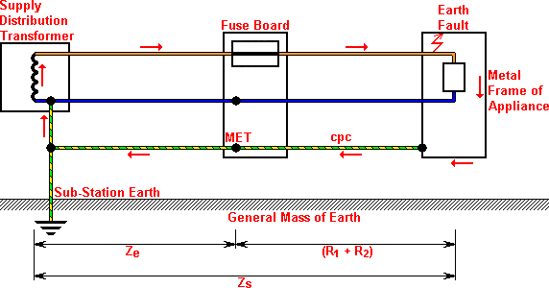
Earth fault loop impedance
The earth fault current path for a TN‑S system is shown in the diagram below:

Slide 3
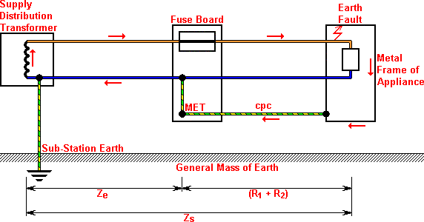
Earth fault loop impedance
The earth fault current path for a TN-C‑S system is shown in the diagram below:

Slide 4
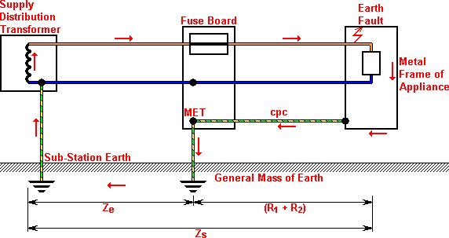
Earth fault loop impedance
The earth fault current path for a TT system is shown in the diagram below:

Slide 5
Earth fault loop impedance
Earth fault loop impedance testing
Z_{S} may be determined by:
measurement of R₁ + R₂ during continuity testing (see earlier notes) and adding to Z_{e}, ie
Z_{S} = Z_{e} + (R₁ + R₂)
Z_{e} is determined by:
measurement, or
enquiry of the electricity supplier, or
calculation, or
direct measurement using and earth fault loop impedance tester.

Slide 6
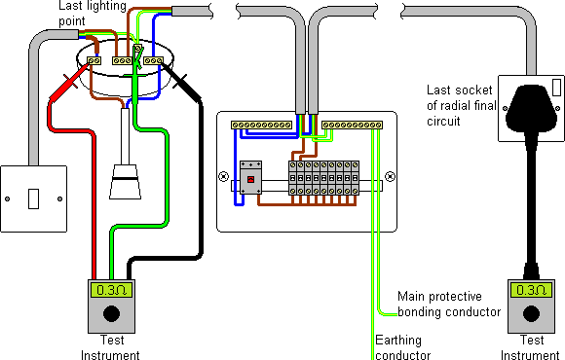
Earth fault loop impedance
Direct measurement of Z_{S}

Slide 7
Earth fault loop impedance
Verification of test results
Values of Z_{S} should be compared with one of the following:
Tabulated values in BS 7671 (Tables 41.2 (page 57), 41.3 (page 58), 41.4 (page 59) and 41.5 (page 60)), corrected for temperature.
Rule‑of‑thumb figures.
Earth fault loop impedance figures provided by the designer.

Slide 8
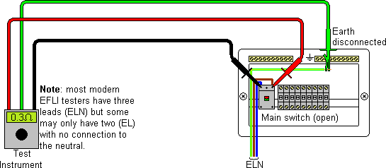
Earth fault loop impedance
Determining Z_{e}
The reasons that Z_{e} is required to be measured are two-fold:
To verify that there is an earth connection.
To verify that the Z_{e} value is equal to or less than the value determined by the designer and used in design calculations.

Slide 9
Any questions?

